Slide 1

PRACTICUM II
Final Presentation
Deep Learning for Image Detection of Breast Cancer
Angela De La Mora
Regis University
August 2019
Powerpoint Templates

Slide 2
Project Overview
Binary classification: cancer vs. no-cancer tissue in medical images
Convolutional Neural Network architecture (aka: CovNet / CNN)
Evolutionary algorithms to find optimal hyperparameters
Total image count: 277,524
Dataset based on seminal paper published in 2014
Dataset downloaded from a republishing blog/author (Janowczyk, 2015)
Comparison with original researchers Cruz-Roa et al. (2014):

Slide 3
Project Steps
W1 - Project research, selection and writing of proposal.
W2 - Prepare hardware/software on local PC.
W3 - Data gathering, cleaning and splitting (training, validation and test sets).
W4 - Exploratory architecture development; exploratory model training.
W5 - Model training; further iterations in architecture and hyperparameters.
W6 - Fine tune model training.
W7 - Compare performance metrics and finalize model selection.
W8 - Build presentation slides, upload to GitHub and present project.

Slide 4
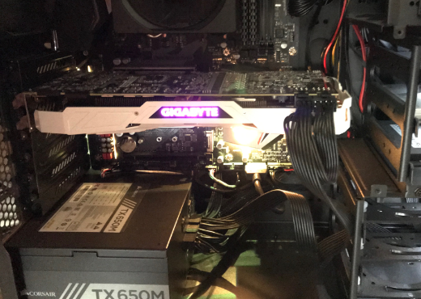
Hardware and software requirements
  Hardware:
    GPU: Nvidia 1080 Ti / 3584 cores / 11 GB RAM
    CPU: AMD Ryzen 2700X / 3.7 GHz / 8 cores / 16 threads
    RAM: 16 GB
  Software:
    Anaconda / Python 3.6
    Tensorflow 1.1 / Keras
    Nvidia Cuda 9.0 / cuDNN
    Jupyter Notebook

Slide 5
Data collection and preparation
Image counts:
  Negative class: 198,738
  Positive class: 78,786
  Total: 277,524
Dataset size: 1.6 GB
Image size: 50 x 50 pixels
Mount slides of breast cancer specimens at 40x magnification
Example positive class images (cancer):
Example negative class images (no cancer):

Slide 6
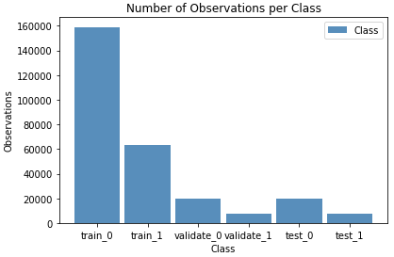
Data collection and preparation
  Categories:
    Negative class: “0”
    Positive class: “1”
  Data splitting by set, class and number of images:
    Training set – Class 0: 158,991 / Class 1: 63,029
    Validation set – Class 0: 19,874 / Class 1: 7,878
    Test set – Class 0: 19,873 / Class 1: 7,879
  Highlights:
    Images selected at random
    Class imbalance present

Slide 7
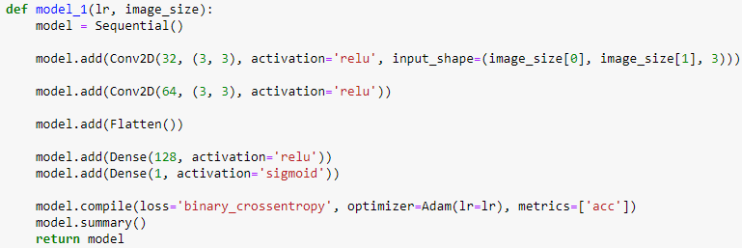
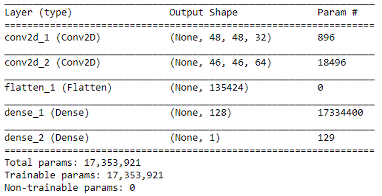
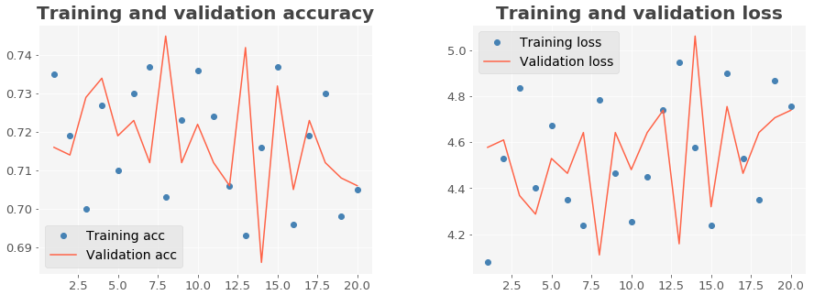
Exploratory model architectures
Attempted a few simple model architectures to gauge performance
Seven models compared
First model not able to learn:

Slide 8

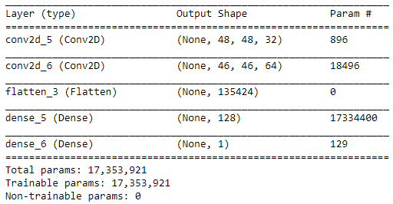
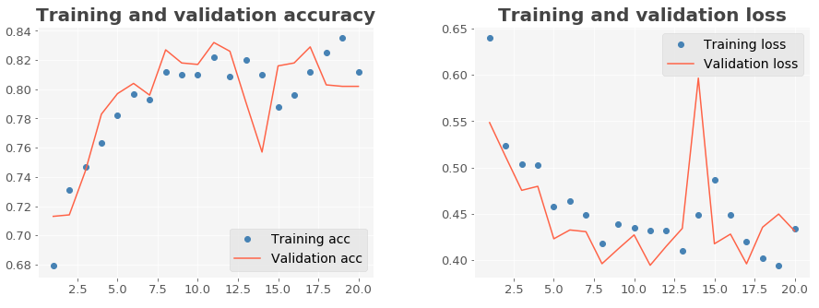
Exploratory model architectures
Hyperparameter combinations were tweaked
The 3rd model shows some improvement:

Slide 9
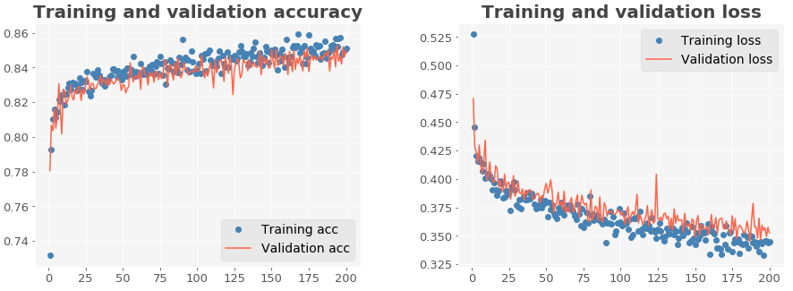
Exploratory model architectures
The 6th model starts showing signs of overfitting, where the training accuracy is consistently higher than the validation accuracy. The same applies to the training loss, which is consistently lower than validation loss:

Slide 10
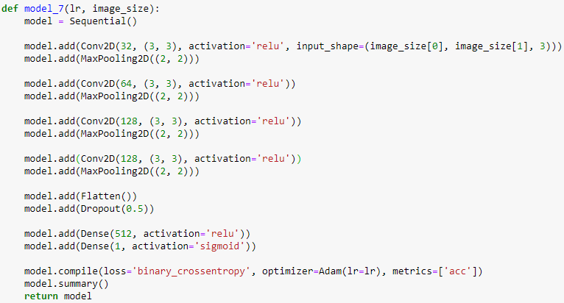
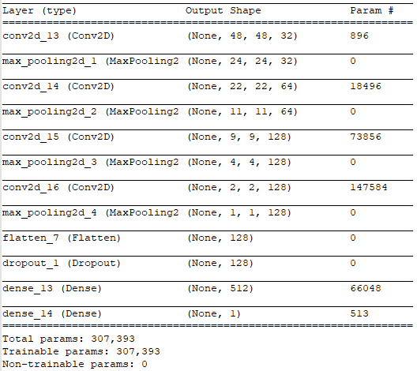
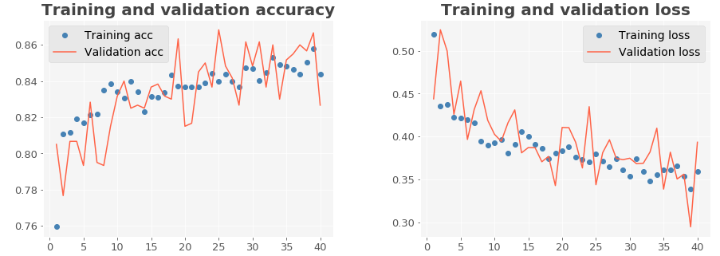
Exploratory model architectures
The 7th model, incorporates more layers and regularization (dropout) to combat overfitting by reducing the number of parameters from 17 million to about 300K.

Slide 11
Evolutionary algorithms
A systematic approach to find an optimal neural network model requires exploring a large combination of architectures and hyperparameters, which is very difficult to do manually (Miikkulainen et al., 2019).
Exploring 5 hyperparameter combinations (learning rate, number of epochs, steps per epoch, validation steps, and batch size) within known reasonable value bounds yields 100K possible models.
Adding model architecture exploration (number of layers, nodes per layer, regularization, pooling, activation functions, etc.) yields a combinatorial explosion of over 10 billion models.
Using 1,000 GPU’s and a conservative average time of 5 minutes to train each model would require almost a million hours, or about 100 years to explore the whole solution space using brute force with current technology!
Evolutionary algorithms use concepts from natural selection processes, especially neuroevolution, and applies them to the process of breeding the most fit models over the course of multiple generations until the best model is found for the task at hand (Stanley et al., 2019).

Slide 12
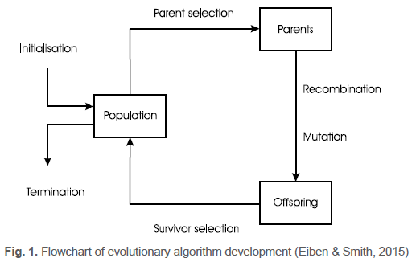
Evolutionary hyperparameter selection
Use evolutionary algorithms instead of brute force or manual exploration
Due to time constraints, only explore hyperparameters
Use best model architecture found during model exploration (model 7)
Hyperparameter values explored:
  Learning rate: 5 values (0.1, 0.01, 0.001, 0.0001, 0.00001)
  Batch size: 10 values (20, 40, 60, 80, 100, 120, 140, 160, 180, 200)
  Epochs: 10 values (10, 20, 30, …, 80, 90, 100)
  Steps per epoch: 20 values (10, 20, 30, …, 180, 190, 200)
  Validation steps: 10 values (10, 20, 30, …, 80, 90, 100)

Slide 13
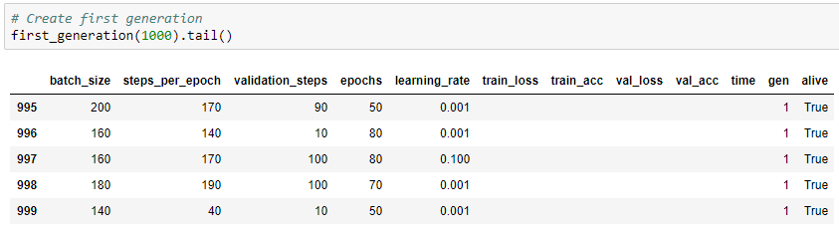
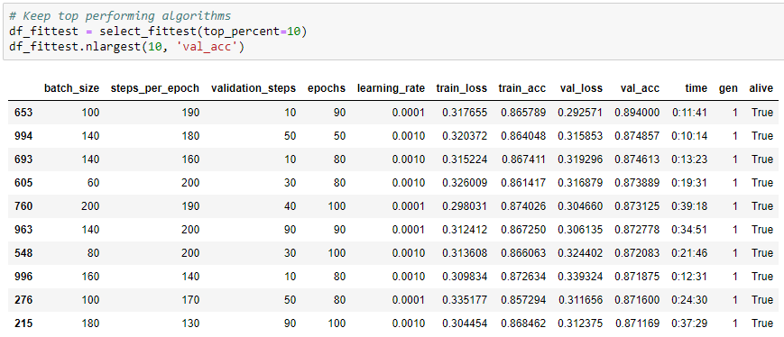
Evolutionary hyperparameter selection
A first generation of 1,000 algorithms was initialized with values selected at random
Survival of the fittest: After training, only the top 10% performing algorithms was selected

Slide 14
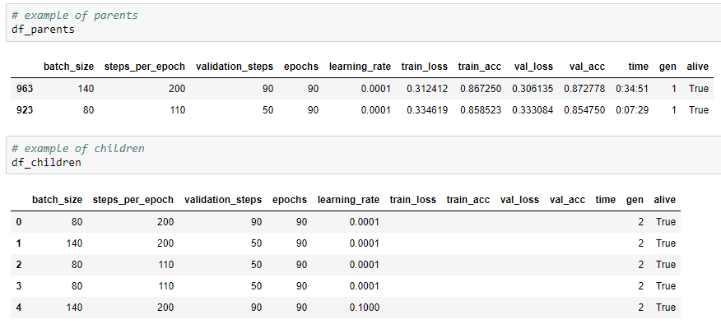
Evolutionary hyperparameter selection
For the second generation, surviving algorithms were matched at random and their chromosomes (hyperparameters) passed to the next generation (genetic inheritance) with a 50% chance of inheriting a chromosome from either parent.
Each set of parents produce 5 offspring at most, excluding offspring with chromosomal combinations previously observed in the population.
A random chromosome mutation was assigned to one child per parent pair, promoting variety in the population and exploration of new values vs. exploitation of known best values.

Slide 15
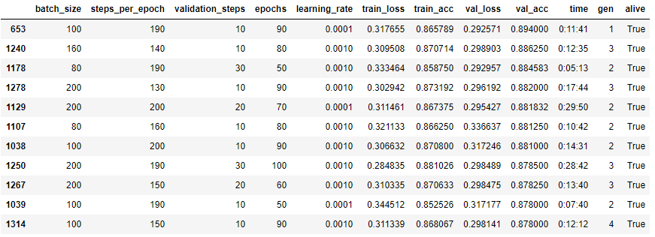
Evolutionary hyperparameter selection
Best-performing algorithms from previous generations were allowed to survive if their validation accuracy fell within the top 10% best-performing algorithms in the population.
A total of 4 generations were evolved
A total of 17 algorithms survived the mass extinctions
Total training time for all generations (1326 algorithms): almost 10 days (237.5 hours)
Best-performing algorithms, based on validation accuracy:
Some algorithms achieved comparable results in less time (i.e., #1178 vs. #1129)

Slide 16
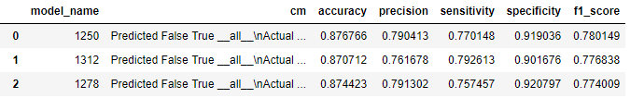
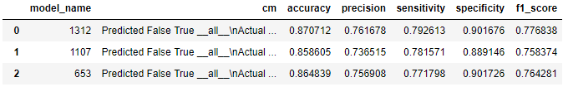
Performance metrics
Predictions on the test set images were run using all of the 17 surviving algorithms
New performance metrics introduced based on predictions:
  Accuracy: How many predictions were correct
  Precision: How many positive predictions were true positives
  Sensitivity/Recall: How many positives were correctly identified (true positive rate)
  Specificity: How many negatives were true negatives
  F1-Score: Weighted average of sensitivity and precision
Accuracy may not be the best performance metric, especially when class imbalance exists
Top performing models, based on F1-Score:
Top performing models, based on Sensitivity/Recall:

Slide 17


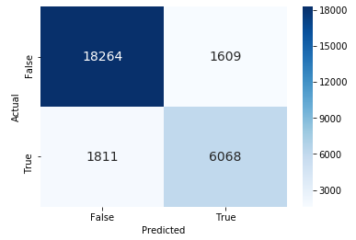
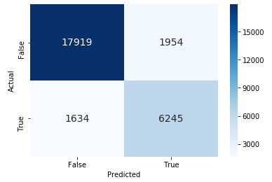
Performance metrics
Confusion Matrix Results
Best model based on F1-Score: Best model based on Sensitivity/Recall:

Slide 18
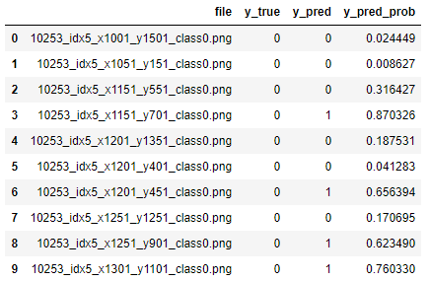
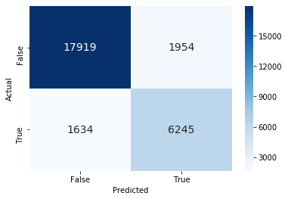
Model selection
Chosen model is the one based on highest sensitivity
Maximizes true positives and minimizes false negatives
Model based on F1-Score is a good balance, but our goal is to flag as many true positives as possible (here, false negatives are worse than false positives)
Example of predicted images →
(probabilities included for reference)
← Confusion matrix of selected model

Slide 19
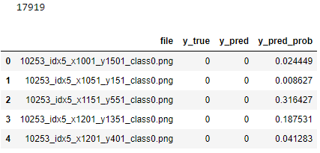
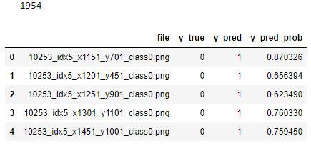
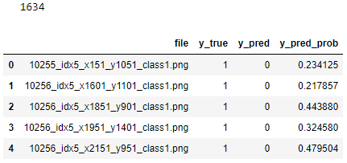
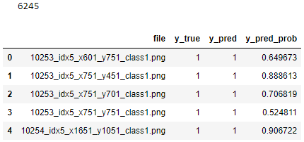
Prediction results
True Negatives False Positives
False Negatives True Positives

Slide 20
Prediction results
True Negatives
False Negatives
True Positives
False Positives

Slide 21
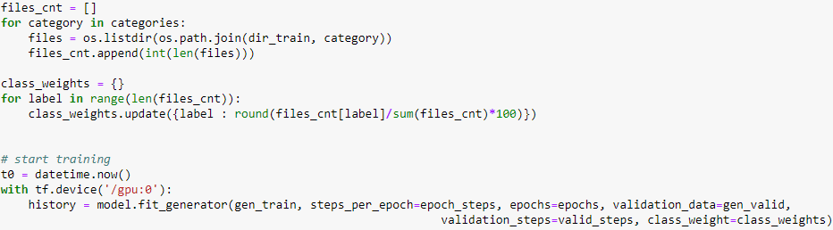
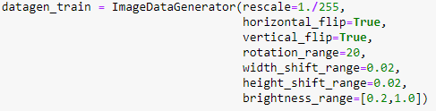
Class imbalance and data augmentation
Class imbalance observed
during data analysis →
Weights can be added for class imbalance during training:
Data augmentation can be
added during training on the fly →

Slide 22
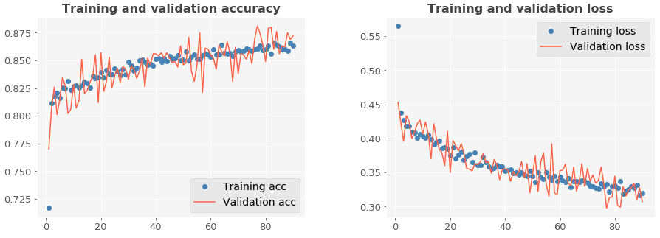
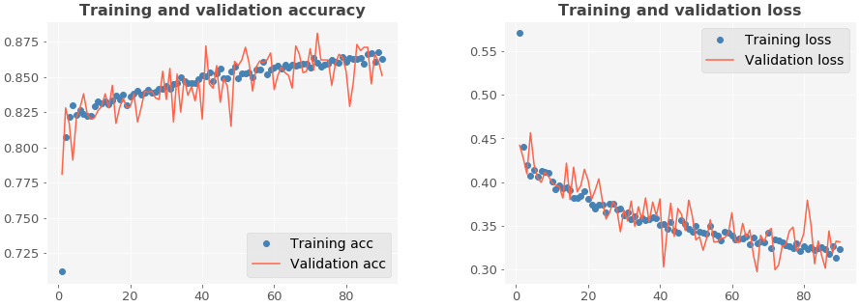
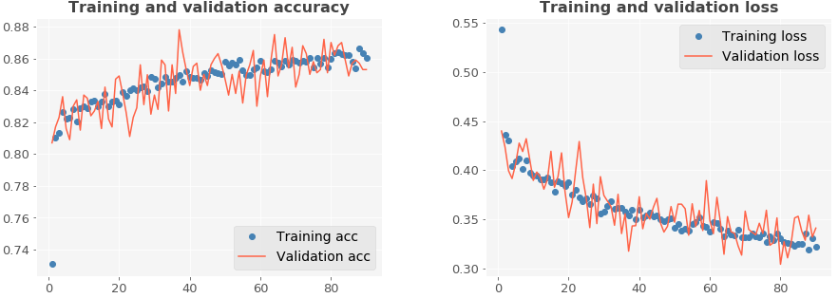
Class imbalance and data augmentation
Retrain best model with no imbalance correction or data augmentation (baseline model)
Retrain best model with class imbalance correction only (no data augmentation)
Retrain best model using class imbalance correction and data augmentation

Slide 23
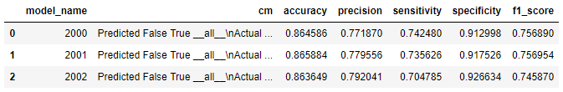
Class imbalance and data augmentation
Correcting for class imbalance did not yield to an improved model
Applying data augmentation also had not positive effect
The model without correction or augmentation performed better

Slide 24
Conclusions
Evolutionary algorithms are a quick and effective alternative to brute force and manual training for deep neural networks.
Binary class imbalance at ~ 70% / 30% did not negatively impact model performance, likely because the small class contains 63K images.
Misclassified images show very close resemblance to the predicted class and error could be due to deficiencies in the original data labeling (this point was also raised on paper by original researchers).
Performance metrics indicate similar results in sensitivity/recall, specificity and balanced accuracy to the baseline model by original researchers; and an important improvement in precision and F-score.

Slide 25
Future research
Expand the use of evolutionary algorithms to include model architecture selection along with hyperparameters.
To account for increased training time, extra GPU’s and RAM could be added, or model could be trained on scalable cloud virtual machines.

Slide 26
References
Cruz-Roa, A., et al. (2014). Automatic detection of invasive ductal
  carciroma in whole slide images with Convolutional Neural Networks. Procedures of SPIE, 9041(904103). Retrieved from https://www.researchgate.net/publication/263052166_Automatic_detection_of_invasive_ductal_carcinoma_in_whole_slide_images_with_Convolutional_Neural_Networks
Eiben, A. E., & Smith, J. E. (2015). Introduction to Evolutionary Computing,
2nd Ed. Amsterdam, The Netherlands: Springer. Print.
Janowczyk, A. (2015). Invasive ductal carcinoma (IDC) segmentation.
  Retrieved from http://www.andrewjanowczyk.com/use-case-6-invasive-ductal-carcinoma-idc-segmentation/

Slide 27
Resources
Repository:
  https://github.com/gelidely/CNN_Breast_Cancer_Detection
Software:
  https://www.tensorflow.org/
  https://keras.io/
  https://www.anaconda.com/
  https://www.nvidia.com/en-us/geforce/products/10series/geforce-gtx-1080-ti/
  https://developer.nvidia.com/cuda-downloads
  https://developer.nvidia.com/cudnn

